Slide 1
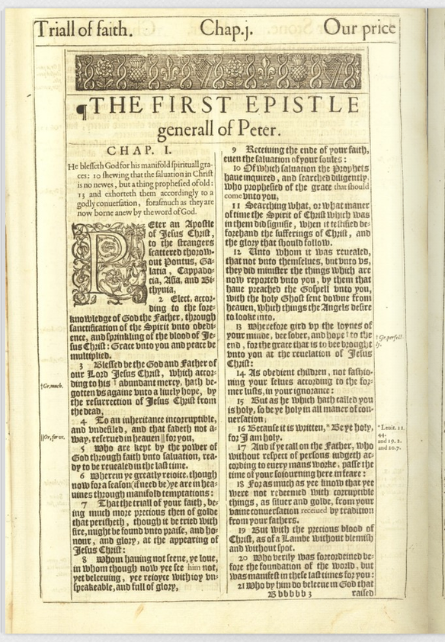
1 Peter Lesson 17
In The Flesh
A verse-by-verse expository study
Jonathan Wheatley
October 19, 2025
Notes:
This is the 17th lesson in the study of 1 Peter. In the previous lesson you learned about the Spirits in Prison, who they are and where they are. You also learned that the Lord Jesus Christ has power, and all these beings are subject unto Him.
In this lesson we start chapter four; you will learn of the sufferings of Christ; that the phrase “In The Flesh” is used four times in this chapter; and we will contrast what it means to be in the flesh versus in the Spirit according to our apostle. You will also learn what the phrase “Preached the gospel unto them that are dead” means in this context.

Slide 2
1 Peter Lesson 17 Chapter 4:1-6
1 Forasmuch then as Christ hath suffered for us in the flesh, arm yourselves likewise with the same mind: for he that hath suffered in the flesh hath ceased from sin; 2 That he no longer should live the rest of his time in the flesh to the lusts of men, but to the will of God. 3 For the time past of our life may suffice us to have wrought the will of the Gentiles, when we walked in lasciviousness, lusts, excess of wine, revellings, banquetings, and abominable idolatries: 4 Wherein they think it strange that ye run not with them to the same excess of riot, speaking evil of you: 5 Who shall give account to him that is ready to judge the quick and the dead. For for this cause was the gospel preached also to them that are dead, that they might be judged according to men in the flesh, but live according to God in the spirit. 1 Peter 4:1-6

Slide 3
1 Peter Lesson 17 Chapter 4:1-6
Verse 1:
Forasmuch then as Christ hath suffered for us in the flesh, (2:21)
arm yourselves likewise with the same mind: (Ro 12:16, 1 Co 1:10)
for he that hath suffered in the flesh hath ceased from sin;
Contrast with Paul:
Romans 12:16 Be of the same mind one toward another. Mind not high things, but condescend to men of low estate. Be not wise in your own conceits.
Romans 6:2 God forbid. How shall we, that are dead to sin, live any longer therein?
Romans 6:7 For he that is dead is freed from sin.
Notes:
Christ hath suffered – 1 Peter 2:21 For even hereunto were ye called: because Christ also suffered for us, leaving us an example, that ye should follow his steps: Proverbs 20:30 The blueness of a wound cleanseth away evil: so do stripes the inward parts of the belly.
Same Mind – Contrast how Paul used the phrase first: Romans 12:16 Be of the same mind one toward another. Mind not high things, but condescend to men of low estate. Be not wise in your own conceits. 1 Corinthians 1:10 Now I beseech you, brethren, by the name of our Lord Jesus Christ, that ye all speak the same thing, and that there be no divisions among you; but that ye be perfectly joined together in the same mind and in the same judgment. Philippians 4:2 I beseech Euodias, and beseech Syntyche, that they be of the same mind in the Lord. Peter used it such that his audience be of the same mind as Christ, and that that they should suffer as he also suffered.
The implication here is that the tribulation Jew’s sufferings are to match the sufferings of Christ. That is, if they don’t suffer they have not ceased from sinning.
Contrast with Paul - Romans 6:2 God forbid. How shall we, that are dead to sin, live any longer therein? Romans 6:7 For he that is dead is freed from sin. Galatians 5:24 And they that are Christ's have crucified the flesh with the affections and lusts.
Colossians 3:3 For ye are dead, and your life is hid with Christ in God. Colossians 3:5 Mortify therefore your members which are upon the earth; fornication, uncleanness, inordinate affection, evil concupiscence, and covetousness, which is idolatry:

Slide 4
1 Peter Lesson 17 Chapter 4:1-6
E
NM
I
T
Y
A
G
A
I
N
S
T
G
O
D
The Flesh
The Spirit
5a For they that are after the flesh do mind the things of the flesh;
6a For to be carnally minded is death;
7 Because the carnal mind is
for it is not subject to the law of God, neither indeed can be.
8 So then they that are in the flesh cannot please God.
9b Now if any man have not the Spirit of Christ, he is none of his.
5b but they that are after the Spirit the things of the Spirit.
6b but to be spiritually minded is life and peace.
9a But ye are not in the flesh,
but in the Spirit,
if so be that the Spirit of God dwell in you.
Notes:
In Romans 8: 5-9, Paul shows the disparity between being in the flesh and in the Spirit.

Slide 5

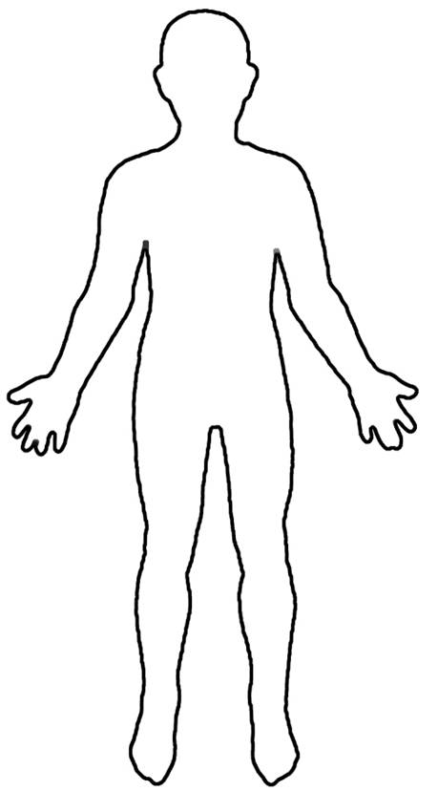
1 Peter Lesson 17 Chapter 4:1-6
Colossians 2:11 In whom also ye are circumcised with the circumcision made without hands, in putting off the body of the sins of the flesh by the circumcision of Christ:
Colossians 2:12 Buried with him in baptism, wherein also ye are risen with him through the faith of the operation of God, who hath raised him from the dead.

Slide 6
1 Peter Lesson 17 Chapter 4:1-6
Verse 2:
That he no longer should live the rest of his time in the flesh to the lusts of men,
but to the will of God. (2:15)
Contrast with Paul:
Romans 14:7 For none of us liveth to himself, and no man dieth to himself.
2 Corinthians 5:15 And that he died for all, that they which live should not henceforth live unto themselves, but unto him which died for them, and rose again.
Titus 2:12 Teaching us that, denying ungodliness and worldly lusts, we should live soberly, righteously, and godly, in this present world;
Notes:
The will of God - 1 Peter 2:15 For so is the will of God, that with well doing ye may put to silence the ignorance of foolish men:
Romans 14:7 For none of us liveth to himself, and no man dieth to himself.
2 Corinthians 5:15 And that he died for all, that they which live should not henceforth live unto themselves, but unto him which died for them, and rose again.
Titus 2:12 Teaching us that, denying ungodliness and worldly lusts, we should live soberly, righteously, and godly, in this present world;

Slide 7
1 Peter Lesson 17 Chapter 4:1-6
Verse 3:
For the time past of our life may suffice us to have wrought the will of the Gentiles,
when we walked in lasciviousness, lusts, excess of wine, revellings, banquetings, and abominable idolatries:
Contrast with Paul:
Romans 11:30 For as ye in times past have not believed God, yet have now obtained mercy through their unbelief:
Galatians 5:21 Envyings, murders, drunkenness, revellings, and such like: of the which I tell you before, as I have also told you in time past, that they which do such things shall not inherit the kingdom of God.
Ephesians 2:11 Wherefore remember, that ye being in time past Gentiles in the flesh, who are called Uncircumcision by that which is called the Circumcision in the flesh made by hands;
Ephesians 2:13 But now in Christ Jesus ye who sometimes were far off are made nigh by the blood of Christ.
Notes:
Time Past – Romans 11:30 For as ye in times past have not believed God, yet have now obtained mercy through their unbelief:
Ezekiel 44:6 And thou shalt say to the rebellious, even to the house of Israel, Thus saith the Lord GOD; O ye house of Israel, let it suffice you of all your abominations,
Acts 14:16 Who in times past suffered all nations to walk in their own ways.
1 Corinthians 12:2 Ye know that ye were Gentiles, carried away unto these dumb idols, even as ye were led.
Galatians 5:20 Idolatry, witchcraft, hatred, variance, emulations, wrath, strife, seditions, heresies, Galatians 5:21 Envyings, murders, drunkenness, revellings, and such like: of the which I tell you before, as I have also told you in time past, that they which do such things shall not inherit the kingdom of God. Ephesians 2:11 Wherefore remember, that ye being in time past Gentiles in the flesh, who are called Uncircumcision by that which is called the Circumcision in the flesh made by hands; Ephesians 2:12 That at that time ye were without Christ, being aliens from the commonwealth of Israel, and strangers from the covenants of promise, having no hope, and without God in the world: Ephesians 2:13 But now in Christ Jesus ye who sometimes were far off are made nigh by the blood of Christ.

Slide 8
1 Peter Lesson 17 Chapter 4:1-6
Verse 4:
Wherein they think it strange that ye run not with them to the same excess of riot, (Ja 4:4)
speaking evil of you: (3:16)
What did Paul say?
1 Corinthians 10:20 But I say, that the things which the Gentiles sacrifice, they sacrifice to devils, and not to God: and I would not that ye should have fellowship with devils.
Notes:
“Don’t smoke, don’t chew, don’t run with them that do!” James 4:4 Ye adulterers and adulteresses, know ye not that the friendship of the world is enmity with God? whosoever therefore will be a friend of the world is the enemy of God.
Who do you run with? Saved folks today also you are known by those that you have fellowship with. What did Paul say?
1 Corinthians 10:20 But I say, that the things which the Gentiles sacrifice, they sacrifice to devils, and not to God: and I would not that ye should have fellowship with devils.
Romans 8:9 But ye are not in the flesh, but in the Spirit, if so be that the Spirit of God dwell in you. Now if any man have not the Spirit of Christ, he is none of his.
1 Peter 3:16 Having a good conscience; that, whereas they speak evil of you, as of evildoers, they may be ashamed that falsely accuse your good conversation in Christ.
Acts 13:45 But when the Jews saw the multitudes, they were filled with envy, and spake against those things which were spoken by Paul, contradicting and blaspheming.

Slide 9
1 Peter Lesson 17 Chapter 4:1-6
Verse 5:
Who shall give account to him that is ready to judge the quick and the dead. (Acts 10:42)
Acts 10:42 And he commanded us to preach unto the people, and to testify that it is he which was ordained of God to be the Judge of quick and dead.
Notes:
There are two types of people: those that are alive (quick) and those that are dead. Acts 10:42 And he commanded us to preach unto the people, and to testify that it is he which was ordained of God to be the Judge of quick and dead.
There are two types of pedestrians: the quick and the dead!

Slide 10
1 Peter Lesson 17 Chapter 4:1-6
Verse 6:
For for this cause was the gospel preached also to them that are dead, (verses 3 & 5)
that they might be judged according to men in the flesh,
but live according to God in the spirit.
Notes:
This preaching the gospel to them that are dead is not him preaching to the spirits in prison 1 Peter 3:19 By which also he went and preached unto the spirits in prison; NO! Was the gospel preached also to them that are dead. I understand this of those who are spiritually dead, that is, the Gentile in verse 3. It also is in line with the previous verse where he refers to the quick and the dead.
This is Peter’s last mention of the phrase “In the Flesh”

